Slide 1
Examples of Experimental Setup
https://www.youtube.com/watch?v=a7uLZL2u3yg
https://www.youtube.com/watch?v=lFhrpSJZzck
https://www.youtube.com/watch?v=ZYbPCBLQnxg&t=43s
https://www.youtube.com/watch?v=1HXcq54NuNM
https://www.youtube.com/watch?v=KucXG9kz0ok
https://www.youtube.com/watch?v=FcNuxk8vDu8&t=36s
https://www.youtube.com/watch?v=rb47Hyg2ci8
**Experiment 2 was done NETL(National Energy Technology Lab) and their result data is attached in the email
University of Houston | Mechanical Engineering

Slide 2
Solid particles used from literatures
Material | diameter | Density | Resource
 | mm | kg/m3 | Author | Link | Journal | Year
Glass Beads | 0.3 | 2500 | Taghipour | https://doi-org.ezproxy.lib.uh.edu/10.1016/j.ces.2005.05.044 | CES | 2005
Corundum | 0.197 | 3940 | Ostermeier | http://dx.doi.org/10.1016/j.powtec.2017.02.015 | PT | 2017
Ceramic | 0.75 | 2700 | Ankit | doi:10.2118/191593-MS | SPE | 2018
Nylon Beads | 3.256 | 1131 | NETL Lab |  |  | 2013
Silicon Carbide | 0.05 |  | Cameron | Chevron | SPE | 2018
University of Houston | Mechanical Engineering

Slide 3
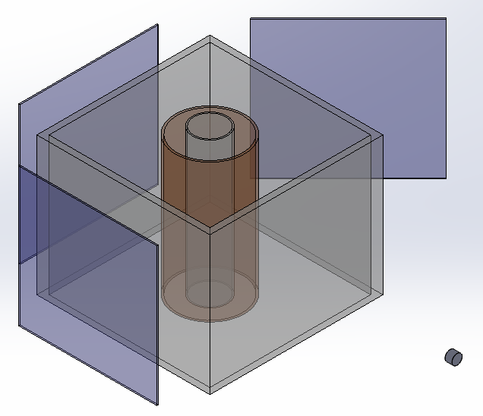
Experimental Setup
LED diffuser
Mirror
Tank
Camera
LED diffuser
University of Houston | Mechanical Engineering

Slide 4
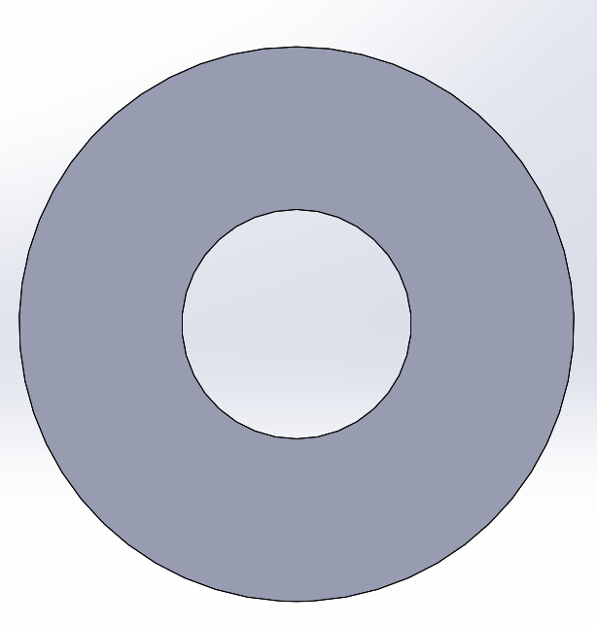
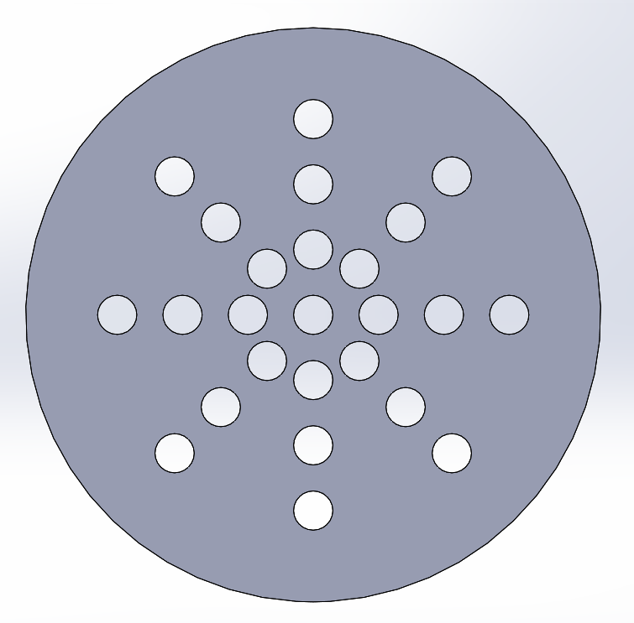
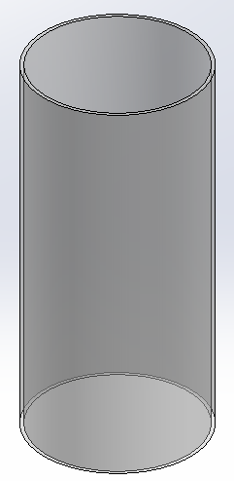
Experimental Setup-1
outlet
Distributor-1
Distributor-2
Analysis:
Change in Minimum fluidization velocity, bed expansion & Pressure drop for:
2 different inflow distributor with same cross-section area
Different particle sizes with same weight
gravel
inlet
Experimental Setup
University of Houston | Mechanical Engineering

Slide 5
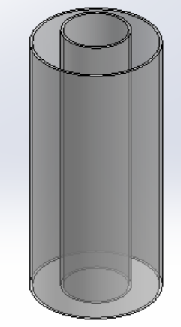
Experimental Setup-2
outlet
Analysis:
Change in Minimum fluidization velocity & Pressure drop for
2 different inflow distributor with same cross-section area
Different particle sizes with same weight
gravel
inlet
University of Houston | Mechanical Engineering

Slide 6
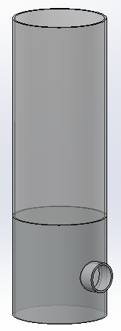
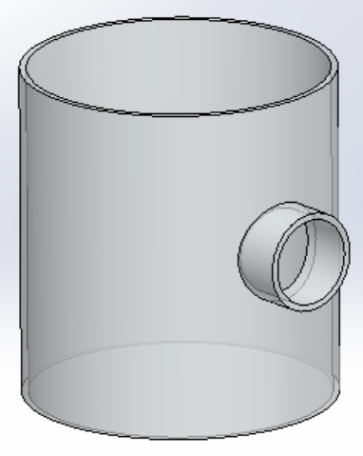
Experimental Setup-3
outlet
inlet
gravel
Part 1
Part 2
Experimental Setup
University of Houston | Mechanical Engineering

Slide 7
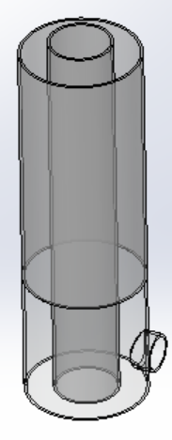
Experimental Setup-4
outlet
inlet
gravel
Part 1
Part 2
Experimental Setup
University of Houston | Mechanical Engineering

Slide 8
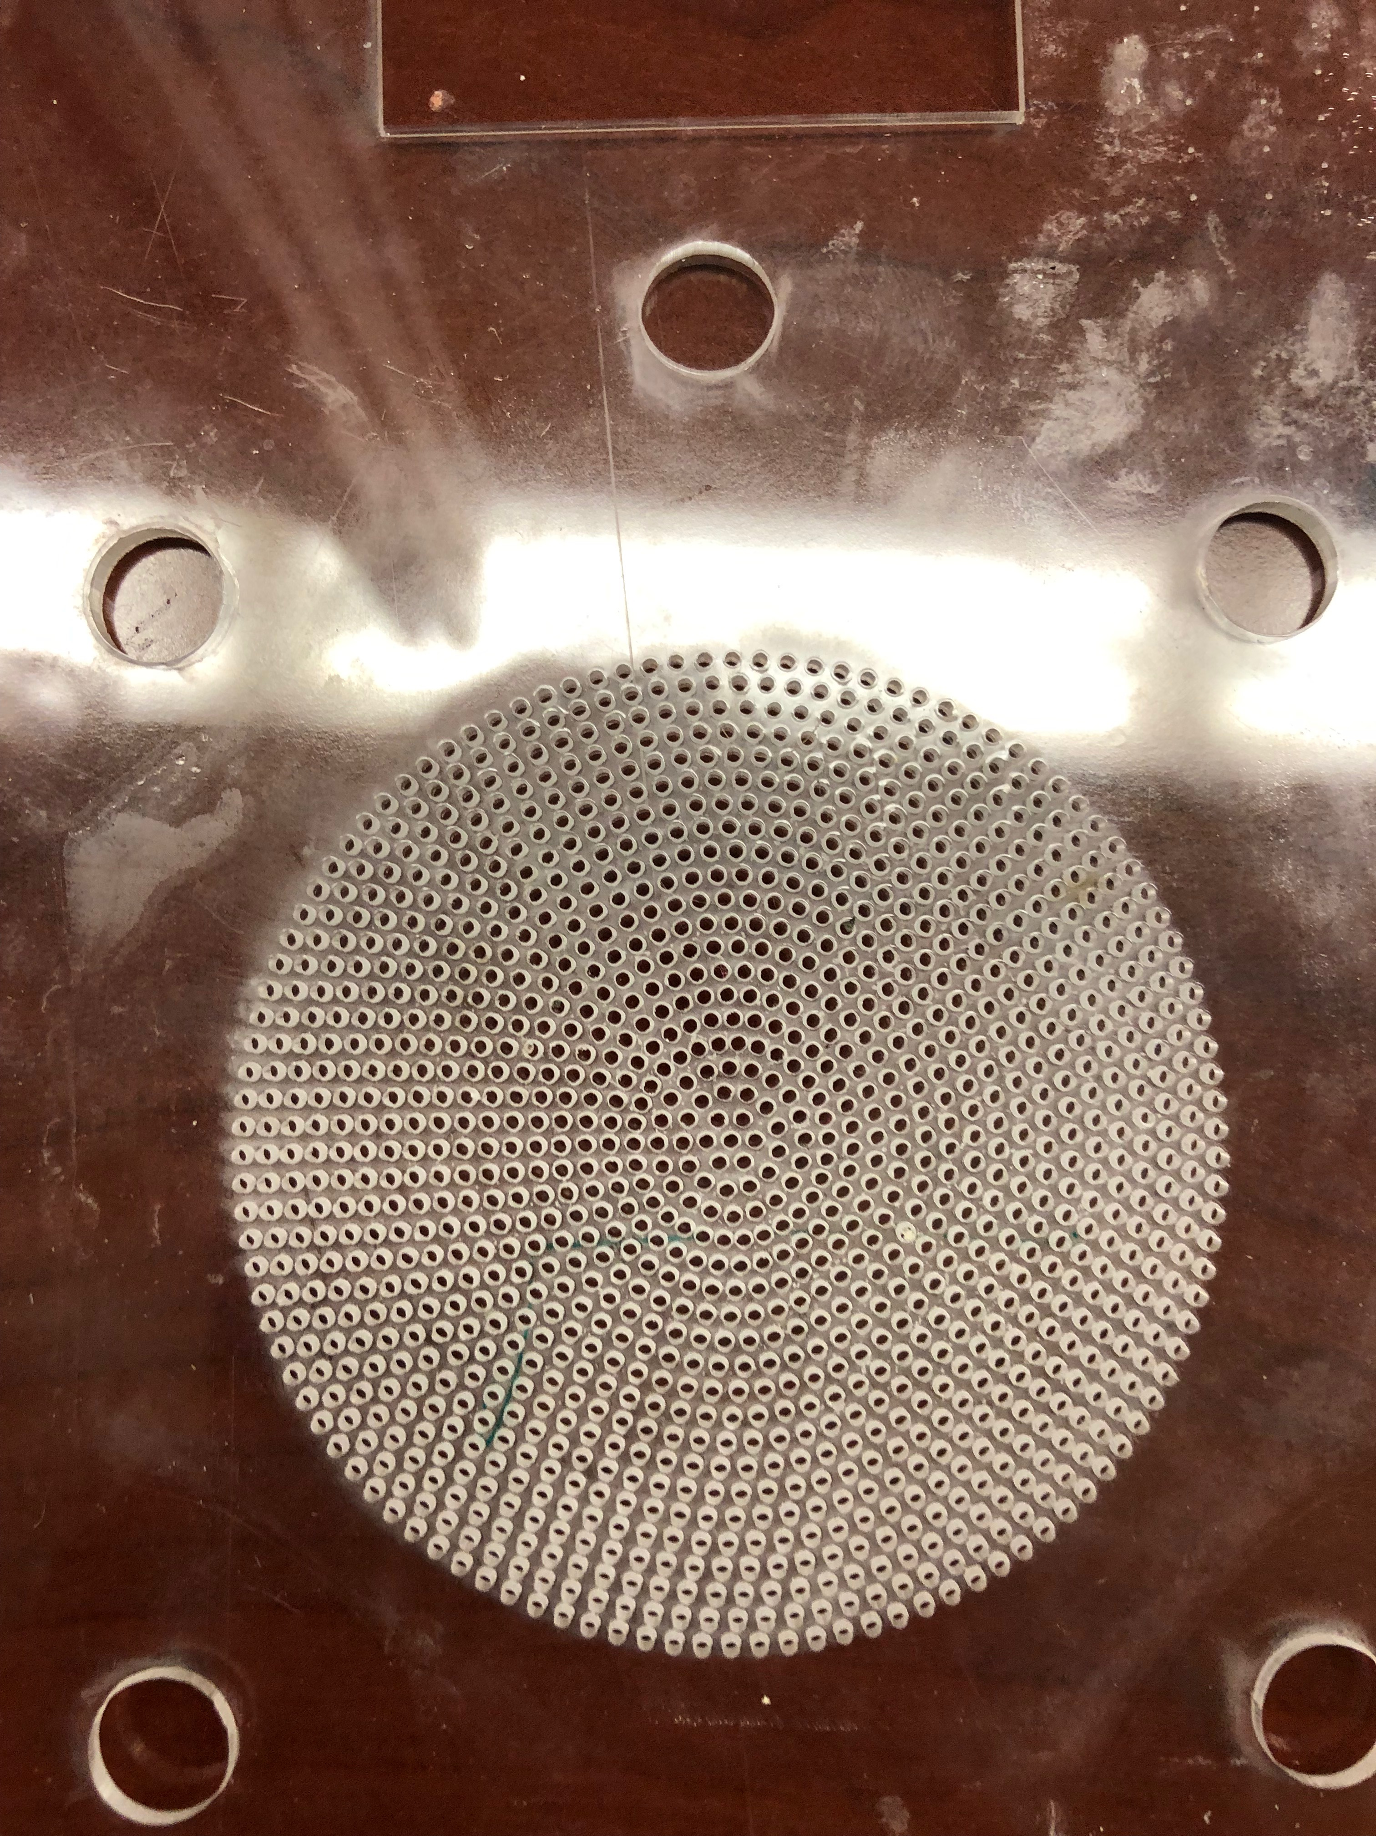
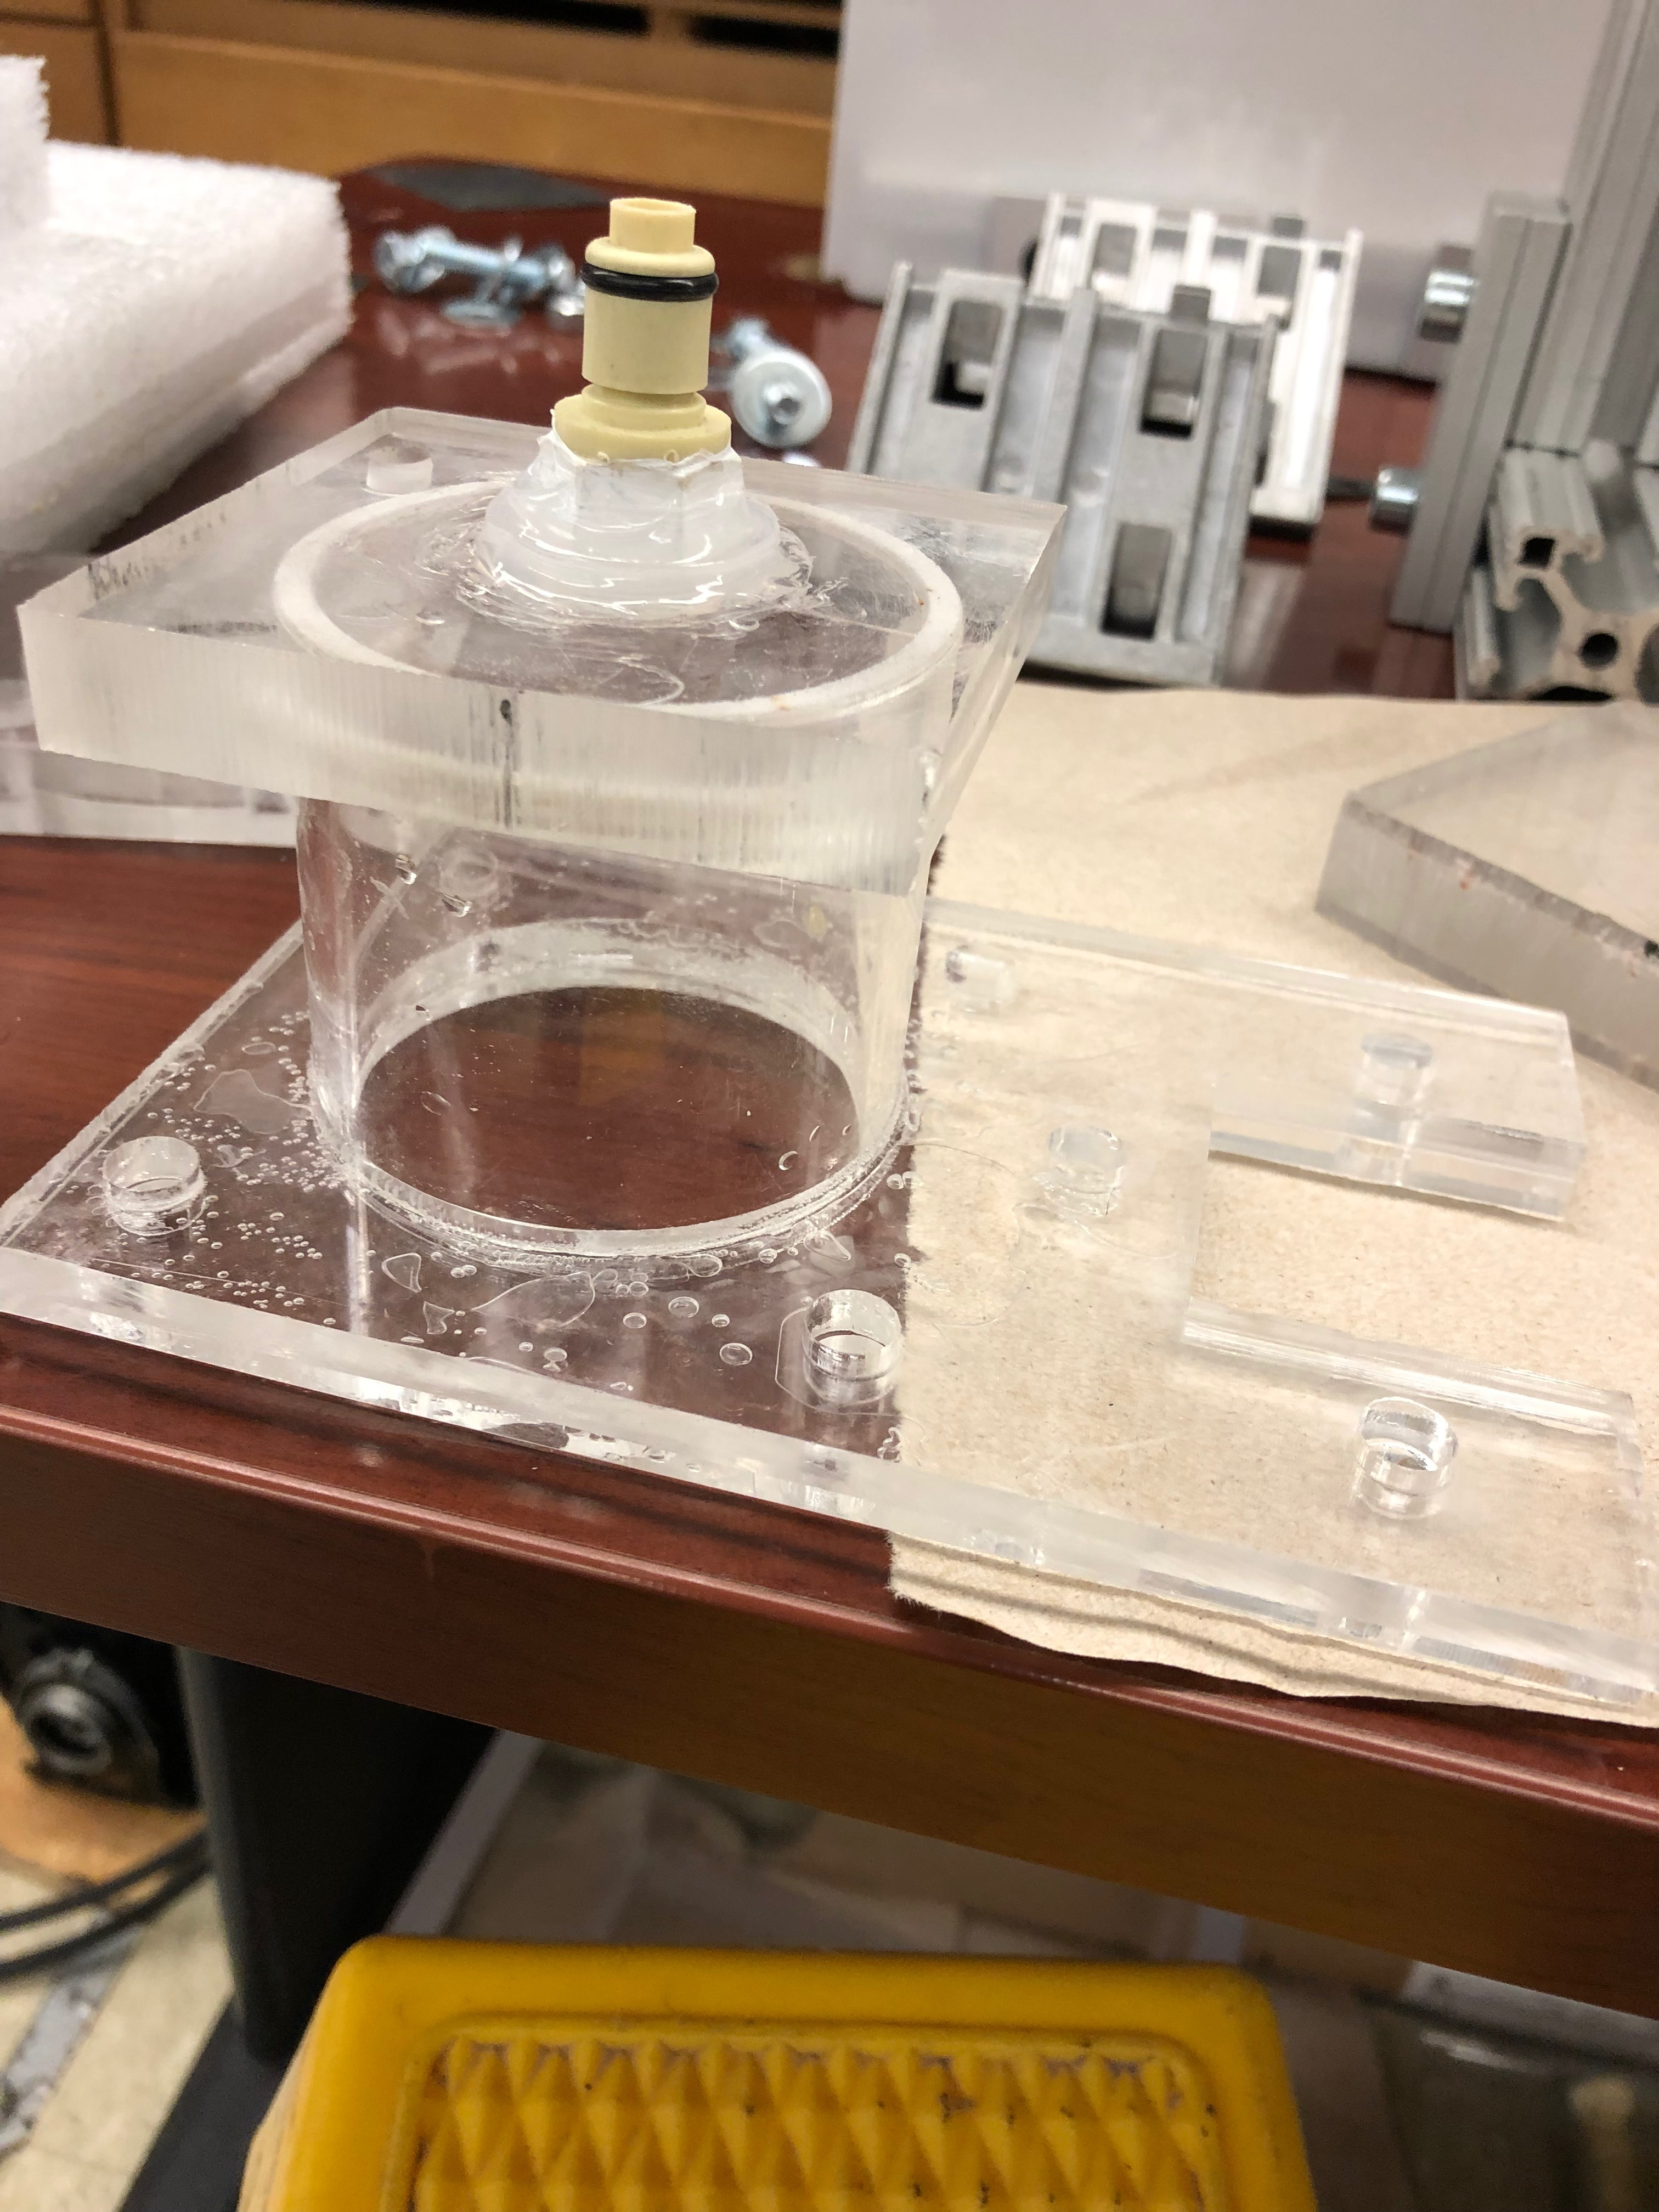

Slide 9
